Slide 1
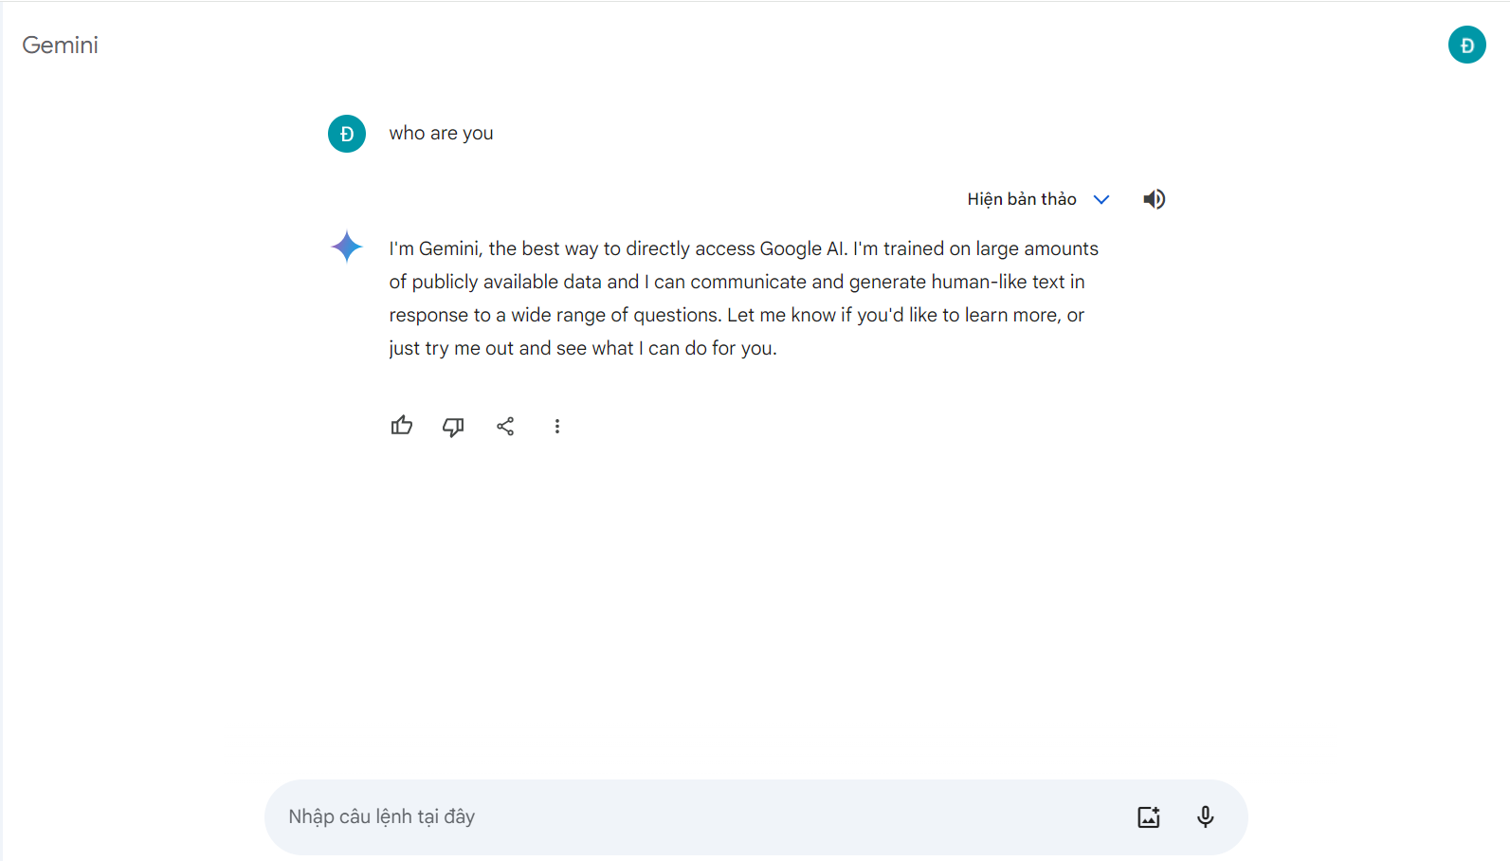
Who are you?
I'm Gemini, the best way to directly access Google AI. I'm trained on large amounts of publicly available data and I can communicate and generate human-like text in response to a wide range of questions. Let me know if you'd like to learn more, or just try me out and see what I can do for you.
Who are you?

Slide 2
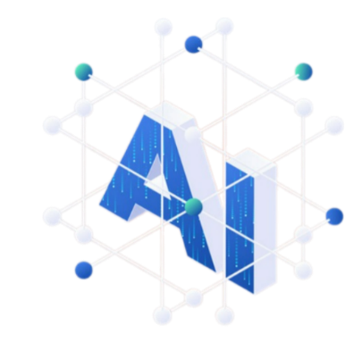










Slide 4




Slide 5



Slide 6



Slide 8
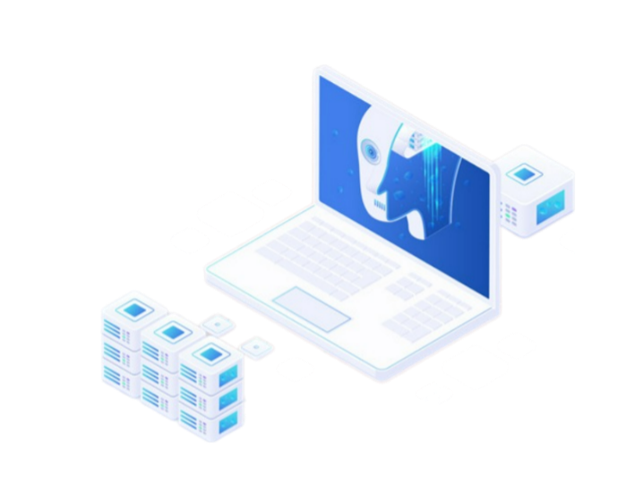

Chatbot
Group 12
Phan Duc Duy 20225831
Pham Duc Long 20225737

Slide 9
01
Concept Of Chatbot
02
03
04
05
06
07
08

Slide 10
01
02
History and development
03
04
05
06
07
08

Slide 11
01
02
03
How chatbots work
04
05
06
07
08

Slide 12
01
02
03
04
Advantages & disadvantages
05
06
07
08

Slide 13
01
02
03
04
05
Chatbot Market
06
07
08

Slide 14
01
02
03
04
05
06
Statistics
07
08

Slide 15
01
02
03
04
05
06
07
Future chatbot
08

Slide 16
01
02
03
04
05
06
07
08
Conclusion

Slide 17
01
Concept Of Chatbot
02
History and development
03
How chatbots work
04
Advantages & disadvantages
05
Chatbot Market
06
Statistics
07
Future chatbot
08
Conclusion

Slide 18
Concept Of Chatbot
Concept Of Chatbot
01
02
What is Chatbot?
03
ChatBot is an application of natural language processing that permits primarily text-based but increasingly voice-based bidirectional dialogues between a user and the digital interface
04
05
06
07
08

Slide 19
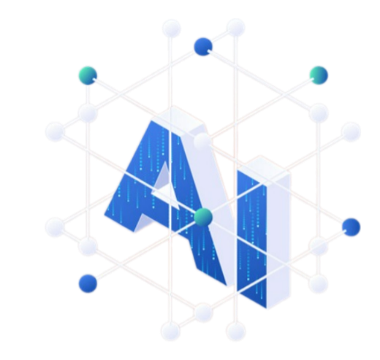



History and development
History And Development
01
02
1950s - 1960s
The concept of chatbots emerged, and ELIZA, one of the earliest chatbots, was created.
1970s – 1990
Rule-based chatbots predominated.
2000s
AI-driven chatbots like IBM's Watson and Apple's Siri gained prominence.
2010s
Chatbots became mainstream in customer service, with platforms like Facebook Messenger and Dialogflow.
2020s
Advanced AI and NLP led to more sophisticated chatbots.
03
04
05
06
07
08

Slide 20
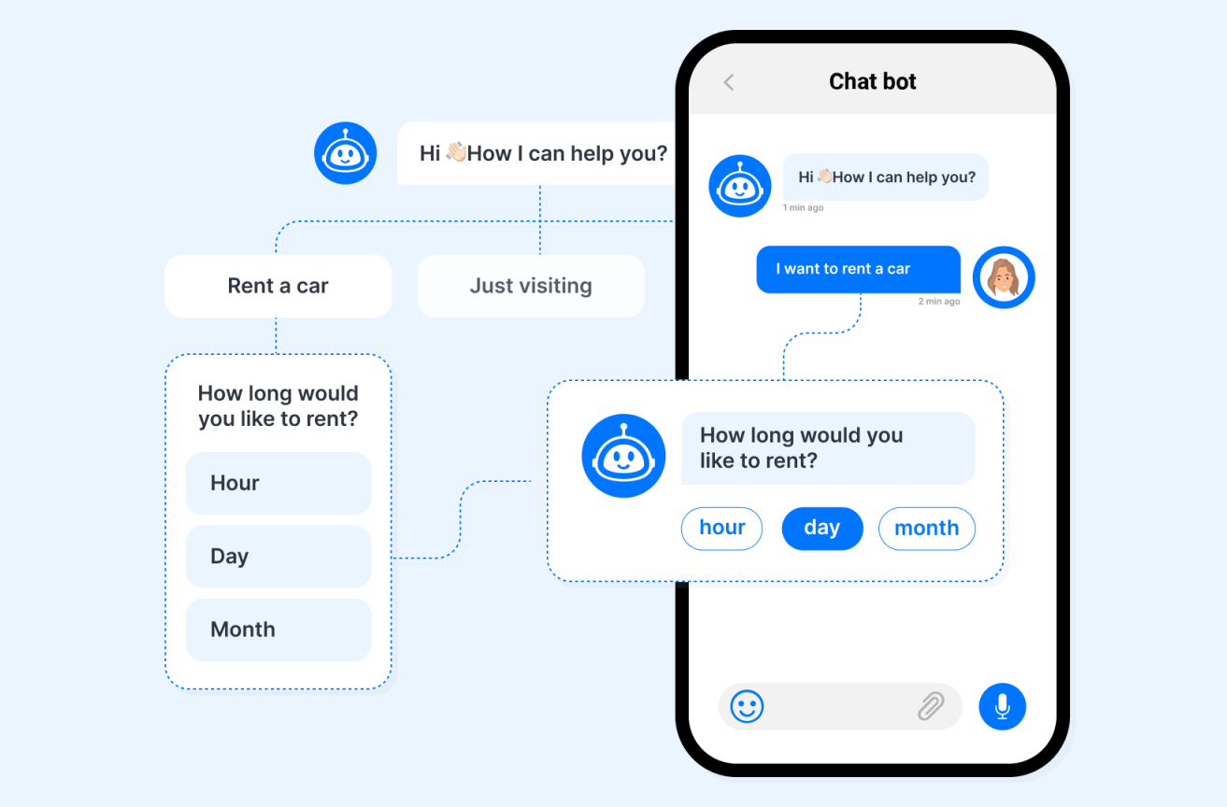
How chatbots work
How Chatbots Work
01
02
03
Chatbots work by using natural language processing and machine learning to understand user input, analyze it for intent and context, and generate appropriate responses based on their training data.
04
05
06
07
08

Slide 21
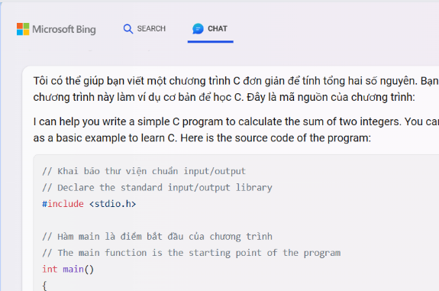
Advantages & disadvantages
Advantages
01
02
They can act as virtual assistants, providing engineers with quick access to information, debugging and writing code, automating tasks.
They can increase engineering efficiency and productivity, creating interactive and participatory design environments.
03
04
05
06
07
08

Slide 22

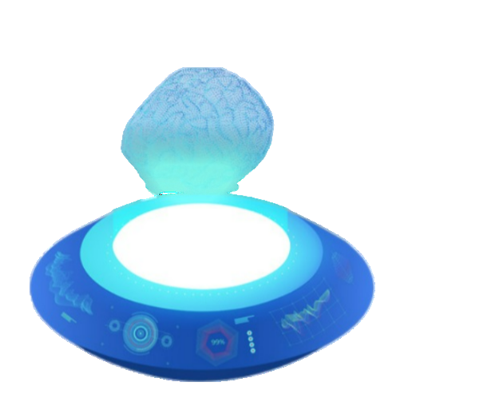
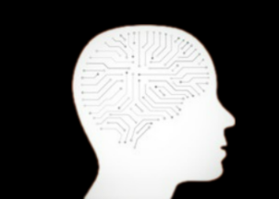

Advantages & disadvantages
Advantages
01
02
03
04
They can act as virtual assistants, providing engineers with quick access to information, debugging and writing code, automating tasks.
They can increase engineering efficiency and productivity, creating interactive and participatory design environments.
They can save costs, reduce human errors, and improve quality, using artificial intelligence, natural language processing, and machine learning.
They can collect engineering data, analyze feedback, and provide insights for better design and development strategies.
Security Concerns: If chatbots collect personal data, robust security measures are crucial to prevent breaches and protect user privacy.
Chatbots can also support engineering education and training, such as providing virtual tutoring, creating course material, and answering student queries.
05
06
07
08

Slide 23
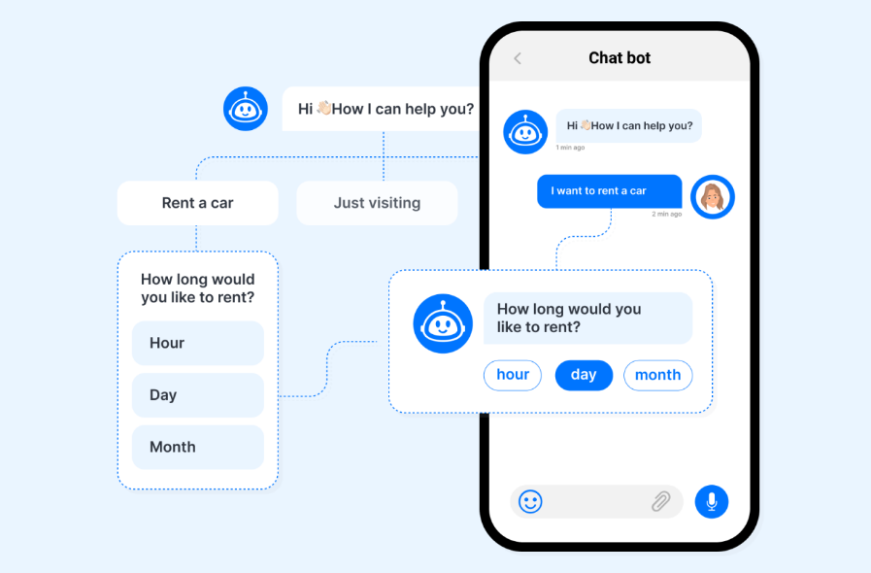
Disadvantages
Advantages & disadvantages
Advantages
01
02
03
04
They can save costs, reduce human errors, and improve quality, using artificial intelligence, natural language processing, and machine learning.
They can collect engineering data, analyze feedback, and provide insights for better design and development strategies.
They can act as virtual assistants, providing engineers with quick access to information, debugging and writing code, automating tasks.
They can increase engineering efficiency and productivity, creating interactive and participatory design environments.
Language Barriers: Understanding natural language can be tricky for chatbots. Complex questions or unexpected requests might stump them.
Security Concerns: If chatbots collect personal data, robust security measures are crucial to prevent breaches and protect user privacy.
Chatbots trained on biased data can perpetuate those biases in their responses. Careful data selection is crucial.
Chatbots can also support engineering education and training, such as providing virtual tutoring, creating course material, and answering student queries.
Chatbots can also support engineering education and training, such as providing virtual tutoring, creating course material, and answering student queries.
05
06
07
08

Slide 24
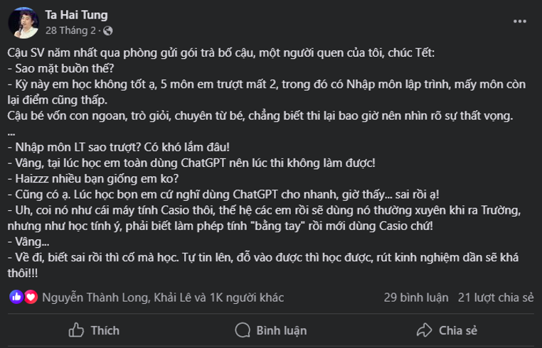
Advantages & disadvantages
Disadvantages
01
02
03
04
05
06
07
08

Slide 25
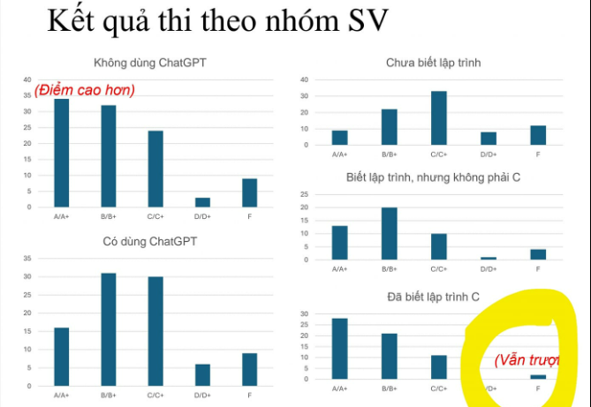
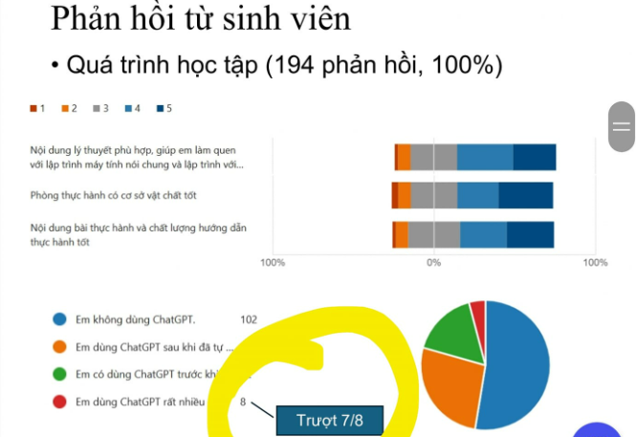
Advantages & disadvantages
Disadvantages
01
02
03
04
05
06
07
08

Slide 26
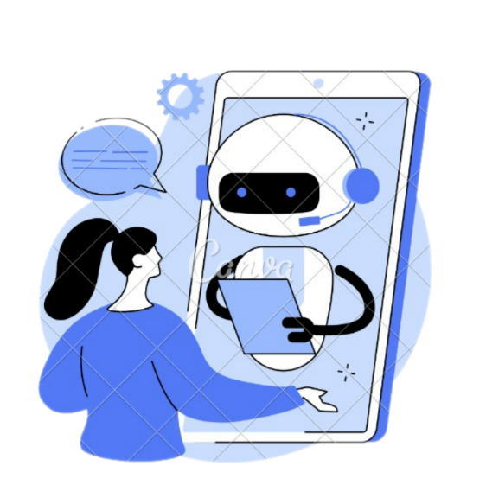

Limitations
Limitations
01
02
03
Empathy Deficit
Chatbots lack the human touch. They can't provide emotional support or deal with situations requiring empathy.
Evolving Needs
Keeping chatbots updated with the latest information and adapting them to evolving customer needs requires ongoing development.
04
05
06
07
08

Slide 27
Limitations
Conclusion
Advantages | Disadvantages
Providing engineers with quick access to information, debugging and writing code, automating tasks. | Chatbots trained on biased data can perpetuate those biases in their responses
Increase engineering efficiency and productivity | Complex questions or unexpected requests might stump them.
Save costs, reduce human errors, and improve quality, | Security Concerns
Chatbotscan collect engineering data, analyze feedback, and provide insights for better design and development strategies. | Can't provide emotional support or deal with situations requiring empathy.
Support engineering education and training | Needs requires ongoing development
 | People tend to overuse it a lot
01
02
03
04
05
06
07
08

Slide 28





Chatbot Market
Chatbot Market
01
02
Banking and Finance
Chatbots are integrated in the banking and finance sector to assist customers with services such as account inquiries, fund transfers, and transaction-related queries.
Customer Service
Chatbots reduce operational costs for businesses by handling customer inquiries and resolving service-related issues through messaging and text.
03
04
Healthcare and Health Services
Healthcare chatbots provide information on symptoms, offer advice on medical conditions, and assist with appointment scheduling.
Payments and Transactions
Chatbots are integrated into payment processing and assist with payment-related queries.
05
06
Retail and E-Commerce
Retail chatbots help customers search for products, place orders, and answer product-related questions.
Education
Chatbot helps students answer questions and find information
07
08

Slide 29
Statistics
Market Statistics
01
02
03
04
05
06
The global market size in 2022 is $5.1B
of which retail and e-commerce account for 30.34%
07
08

Slide 30
Statistics
User Statistics
01
Chatbot
02
134,565,694
300,000
03
Chats were held by ChatBot in 2023
The number of chatbots currently active is on Facebook Messenger alone
04
05
88%
62%
06
Of customers had a first_hand experience and chatted with a bot
Of customers ready to use chatbot
07
08

Slide 31
Statistics
User Statistics
01
21% neutral
02
03
88%
04
05
06
10% not satisfied
69% satisfied
07
08

Slide 32
Future chatbot
01
02
03
Future Chatbot?
04
05
06
07
08

Slide 33
Future chatbot
Future Chatbot
01
02
03
04
Market size value in 2023 is $6.3B
Growth rate 23.3%
Revenue forecast for 2030 is $27.2B
05
06
07
08

Slide 34
Conclusion
Conclusion
01
02
Chatbots are a powerful tool, but they should complement, not replace, human interaction.
03
04
By understanding the limitations and addressing potential downsides, chatbots can significantly enhance customer service experiences.
05
06
The chatbot market is rapidly growing and has a promising future. However, there are still some limitations that need to be addressed before chatbots can reach their full potential.
07
08

Slide 35
References
facebook.com/tahaitung?locale=vi_VN
landbot.io/blog/future-of-chatbots
grandviewresearch.com/industry-analysis/chatbot-market
tidio.com/blog/chatbot-statistics/

Slide 36
Thanks for listening

